Slide 1


Geospatial modelling to assess drivers of infectious disease spread CADDE Workshop on Portable Metagenomics for Pathogen Surveillance 13 – 17 March, Sao Paulo, Brazil
Sabrina Li, DPhil
Assistant Professor in Quantitative Geography
University of Nottingham, UK
17 March 2023

Slide 2


Overview
Introduction – why mapping?
Applications of geospatial modelling
Predicting yellow fever emergence in Brazil
Exploring geographical inequalities in COVID-19 testing in São Paulo
Assessing COVID-19 mortality and racial and social inequalities in São Paulo
Mapping tutorial
sabrina.li@nottingham.ac.uk
@sabrinalyli

Slide 3


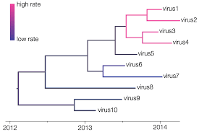
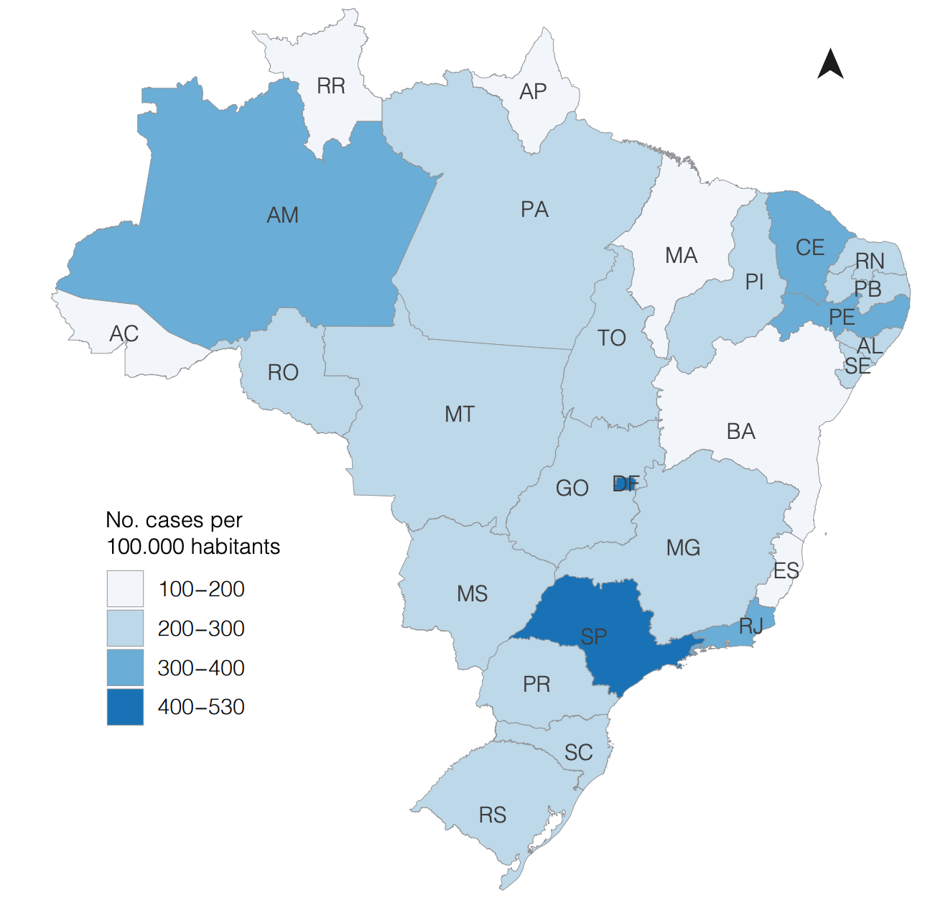
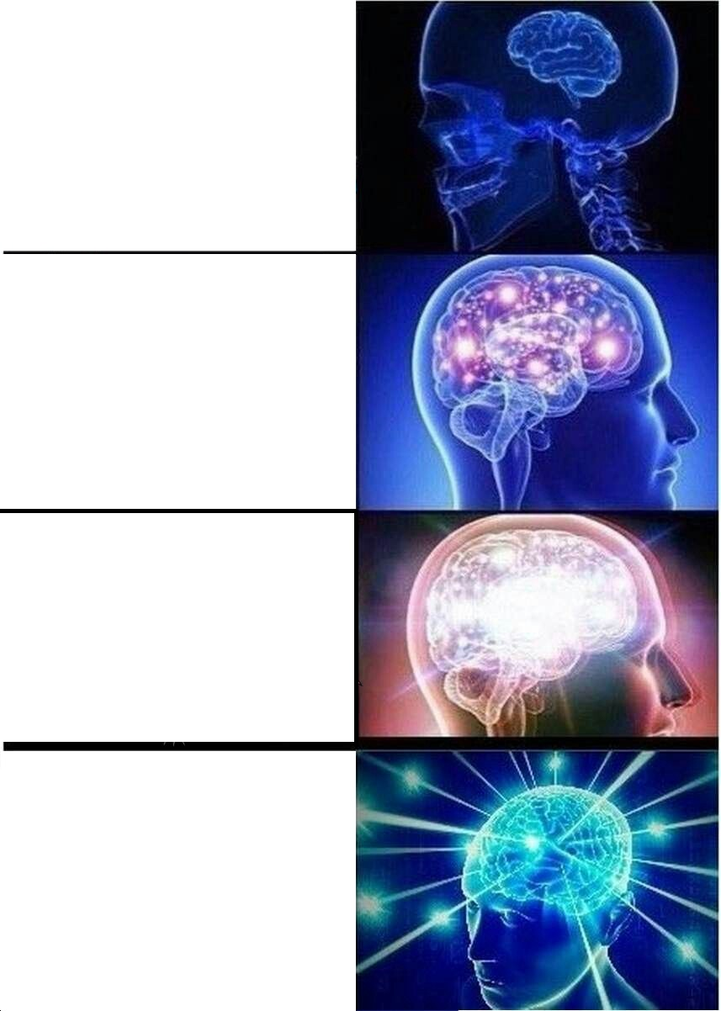
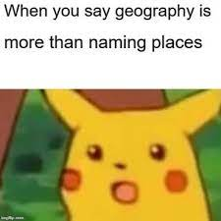
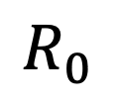
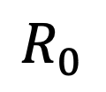
Introduction
$$R_{0}$$
$$R_{0}$$
sabrina.li@nottingham.ac.uk
@sabrinalyli

Slide 4
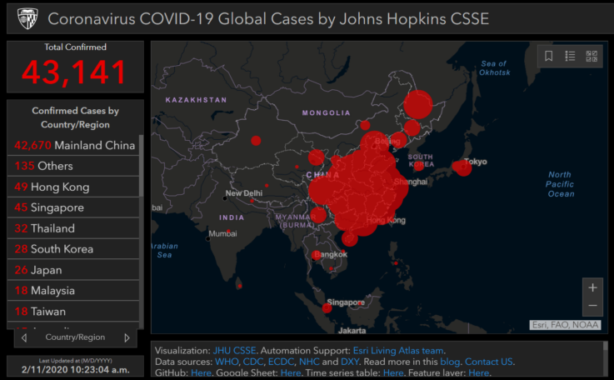
Maps for impact
Surveillance and monitoring
Resource delivery – where and who?
Inclusive intervention design
sabrina.li@nottingham.ac.uk
@sabrinalyli

Slide 5
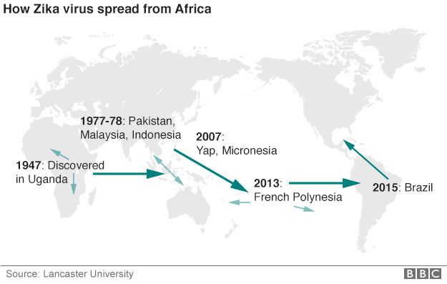
What is spatial modelling? Let’s look at applications for the 2016 Zika epidemic…
sabrina.li@nottingham.ac.uk
@sabrinalyli

Slide 6
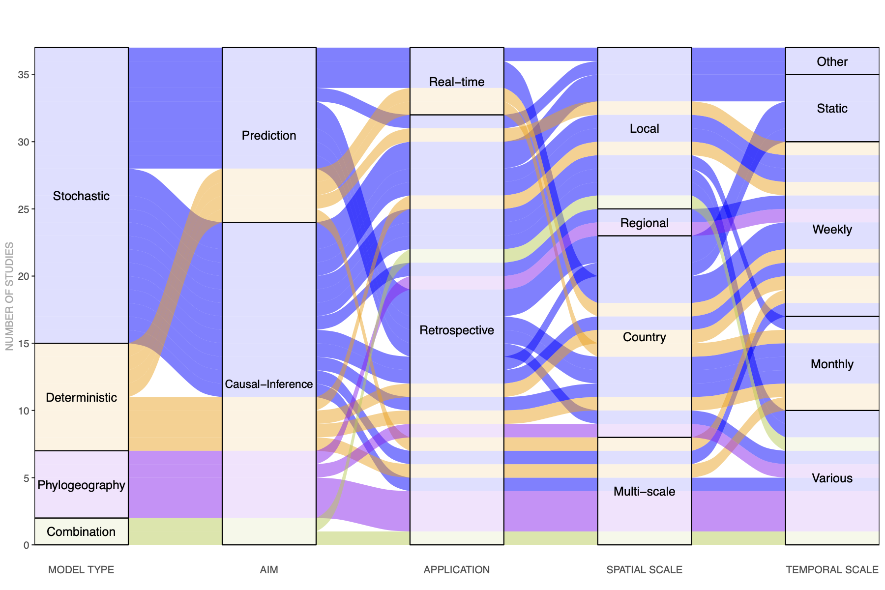
Models to investigate the geographic spread of Zika
What are these models used for?
When and where future outbreaks may occur
Effects of risk factors that facilitate spread
Li et al. (2021) Transactions of The Royal Society of Tropical Medicine and Hygiene.
sabrina.li@nottingham.ac.uk
@sabrinalyli

Slide 7
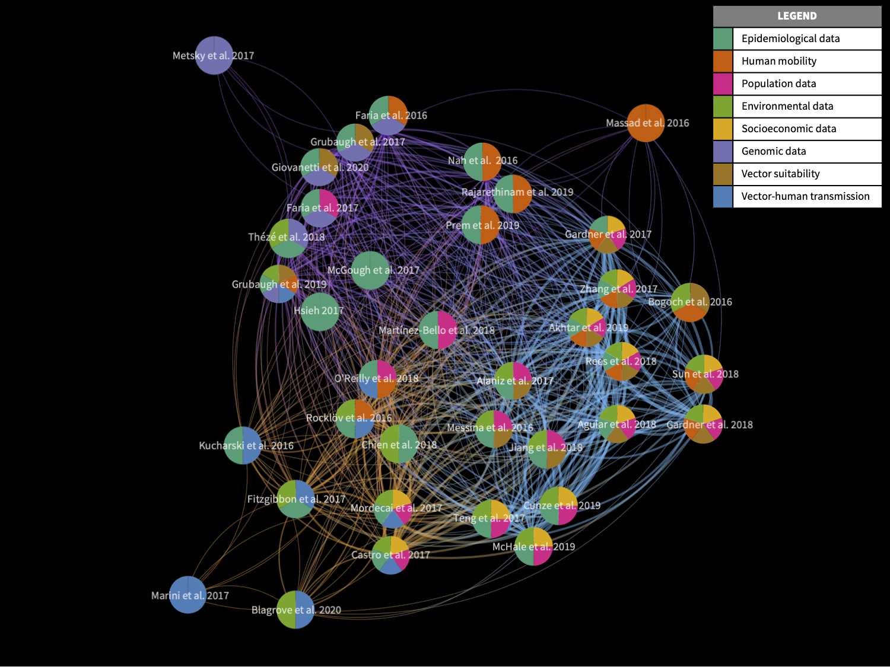
Integration of data
Data considerations:
Spatial resolution (individual level, population level, administrative-level, etc.)
Temporal resolution (static, or across time e.g. weekly, monthly, yearly)
Source: open access vs private
Li et al. (2021) Transactions of The Royal Society of Tropical Medicine and Hygiene.
sabrina.li@nottingham.ac.uk
@sabrinalyli

Slide 8
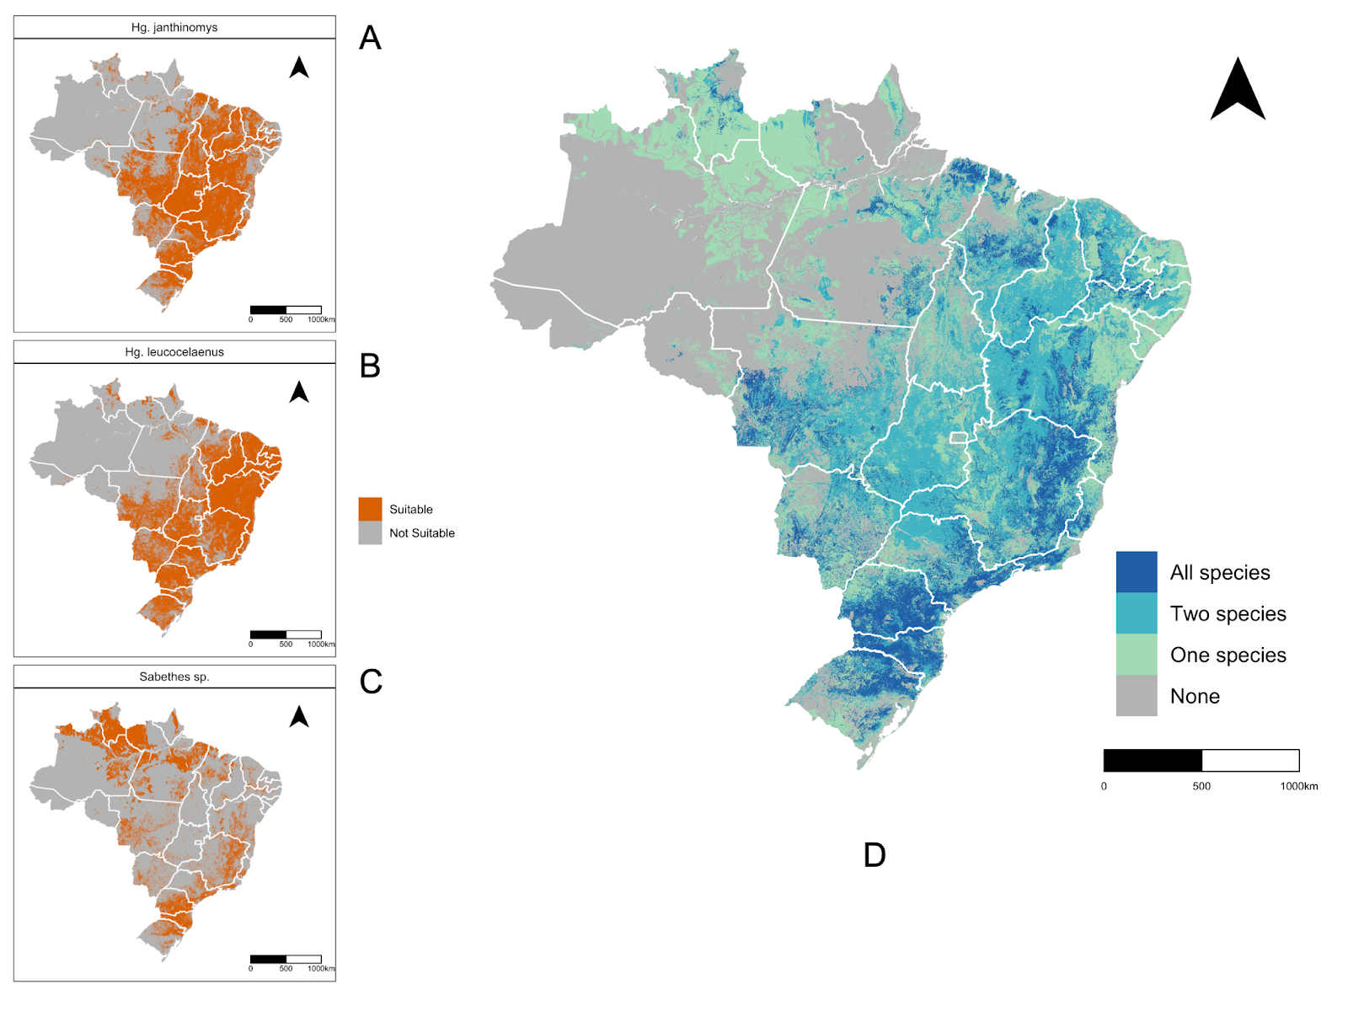
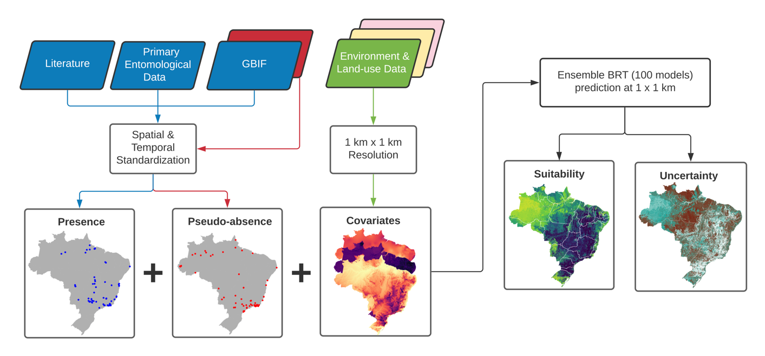
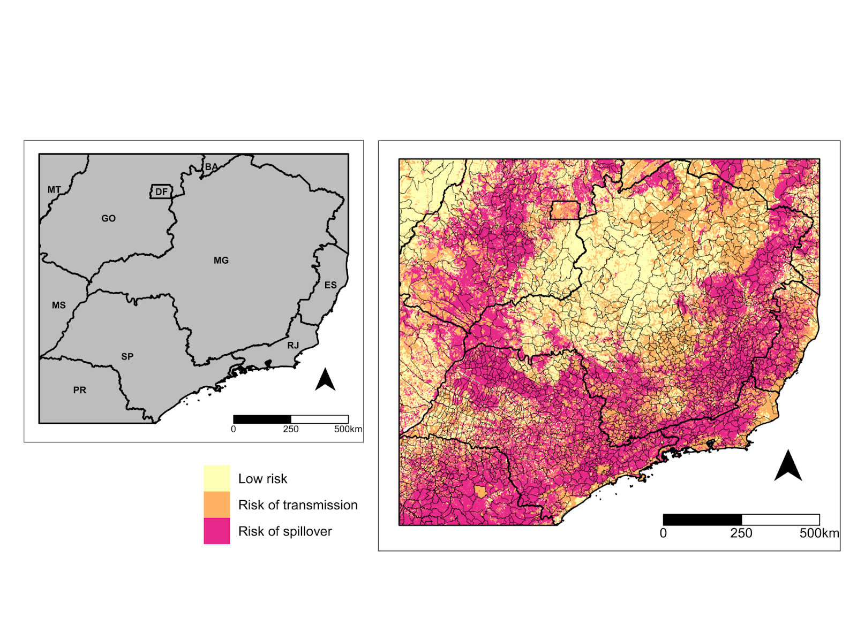
Predicting yellow fever emergence in Brazil
Geographical data can help us predict disease emergence and risk at high spatial resolution
Li et al. (2022). PLOS Neglected Tropical Diseases.
sabrina.li@nottingham.ac.uk
@sabrinalyli

Slide 9
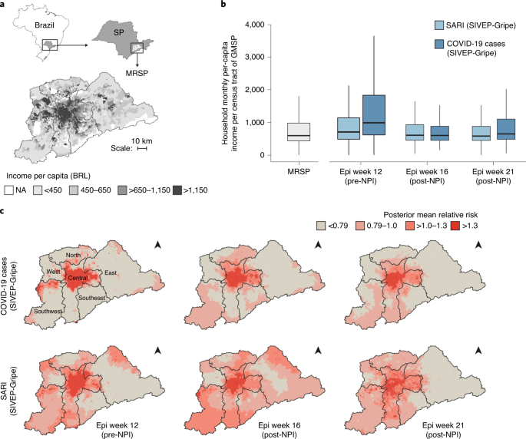
Geographical inequalities in COVID-19 testing in São Paulo
Spatial data analysis allows us to understand geographical inequalities
de Souza et al. (2021). Nature Human Behaviour.
sabrina.li@nottingham.ac.uk
@sabrinalyli

Slide 10
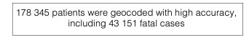
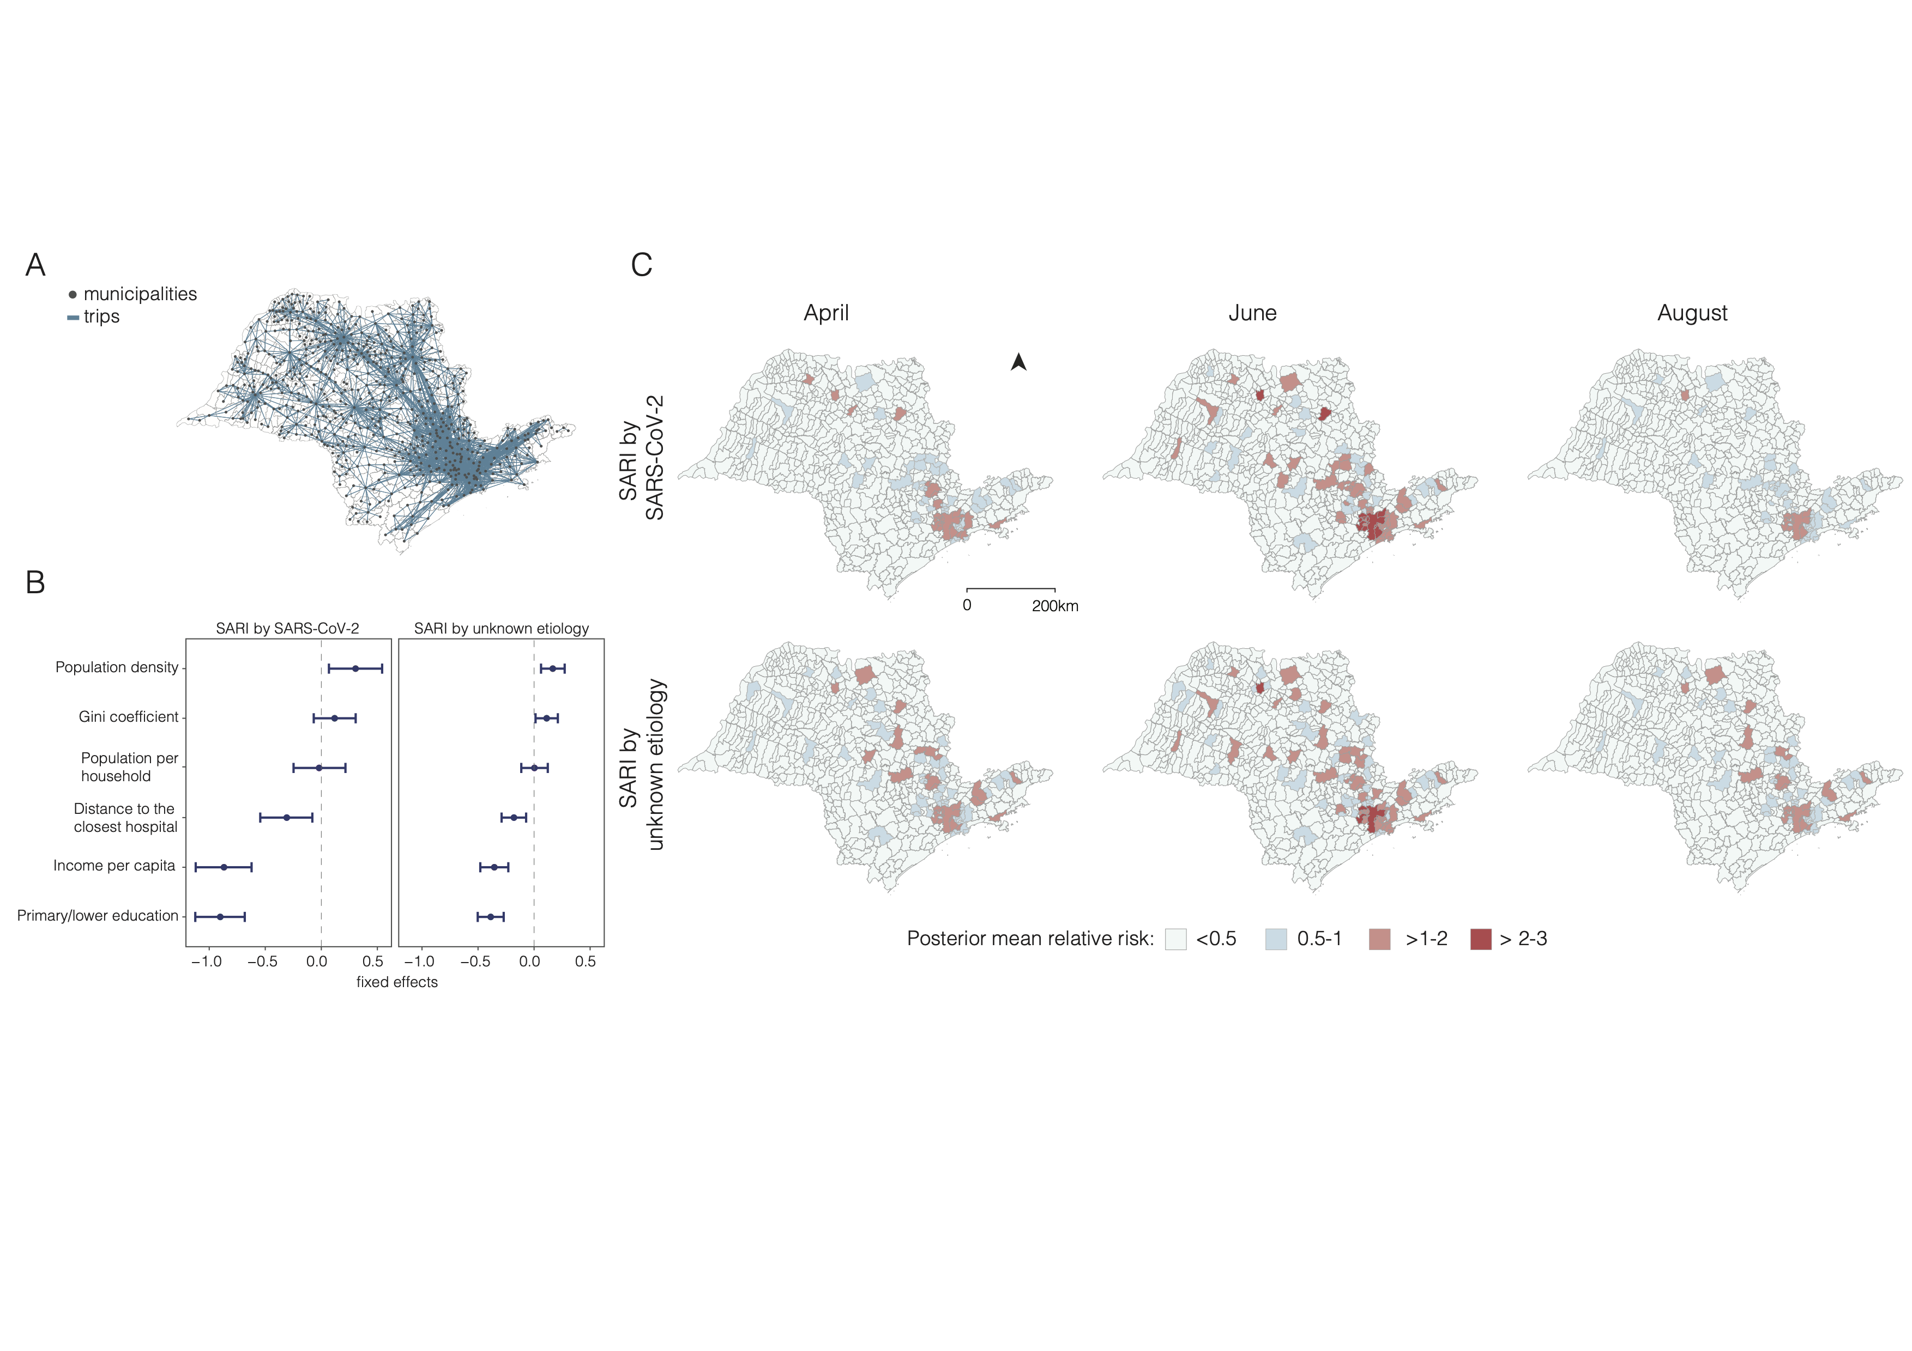
Health inequalities and COVID-19 mortality
Geospatial modelling allows us to understand how environmental factors contribute to geographical risk
Li et al. (2021). BMJ Global Health.
sabrina.li@nottingham.ac.uk
@sabrinalyli

Slide 11
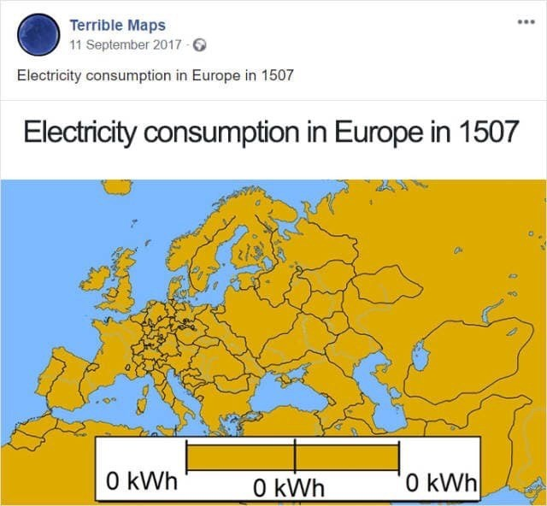
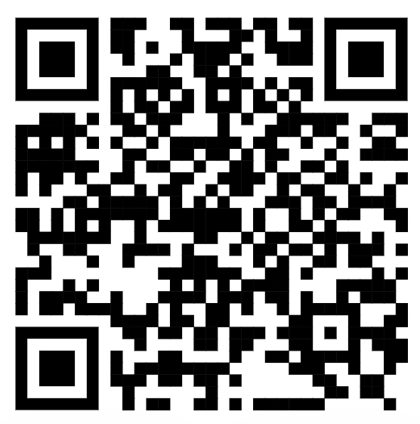
Mapping tutorial
Tutorial Instructions
https://sabrinalyli.github.io/

Slide 12


Thank you for listening!
Feel free to get in touch:
Interested in a PhD in the UK?
Fully-funded PhD studentships in the School of Geography beginning in Autumn 2023
Sabrina.li@nottingham.ac.uk
@sabrinalyli
https://sabrinalyli.com/

